Slide 1

XNA Console
Game & Simulation Technology
Patrick Wieczorek 12th January 2010

Slide 2
Agenda
Introduction
Features
Implementation
How it works
Summary

Slide 3
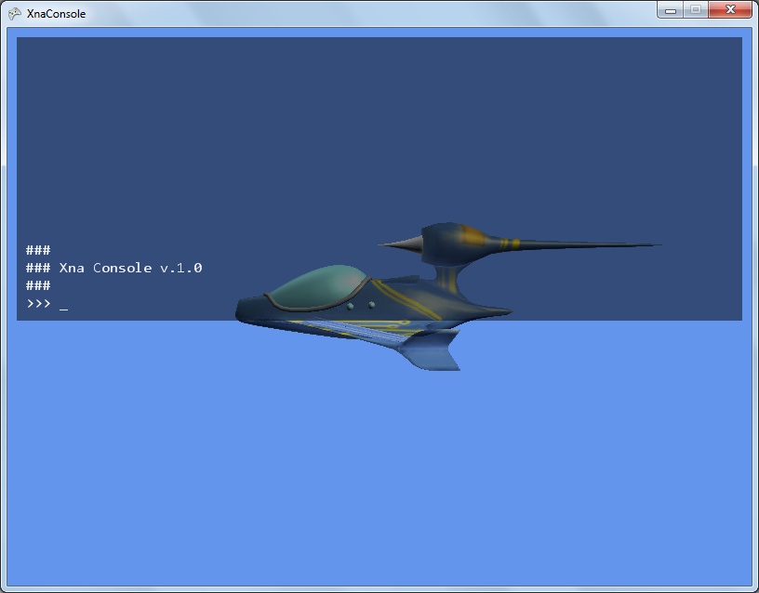
Introduction
Basic console
Uses IronPython as interpreter
Current release Beta v. 1.01 8th Novemer 2008
Downloads: 954

Slide 4
Introduction
XNA 3.0 compatible
License: no license improvements may be published back
Developer: Shader (no real name) last visit 27th November 2010
No maintainance, no license, no rules
Do whatever you want
Notes:
freebee

Slide 5
Features
Read out variables
(Write to variables)
Other interpreters can be implemented
command history and cursor

Slide 6
Implementation
Files /
content/
consola.ttf
ConsoleFont.spritefont
lib/
IronMath.dll
IronPython.dll
KeyBindings.cs
PythonInterpreter.cs
XnaConsole.cs

Slide 7
Implementation
Basic implementation in Game class PythonInterpreter interp; Initialize() { interp = new PythonInterpreter(this, Content.Load<SpriteFont>("ConsoleFont")); }
Registering variables Initialize() { … int aNumber = 1; interp.AddGlobal(„max“, aNumber); }

Slide 8
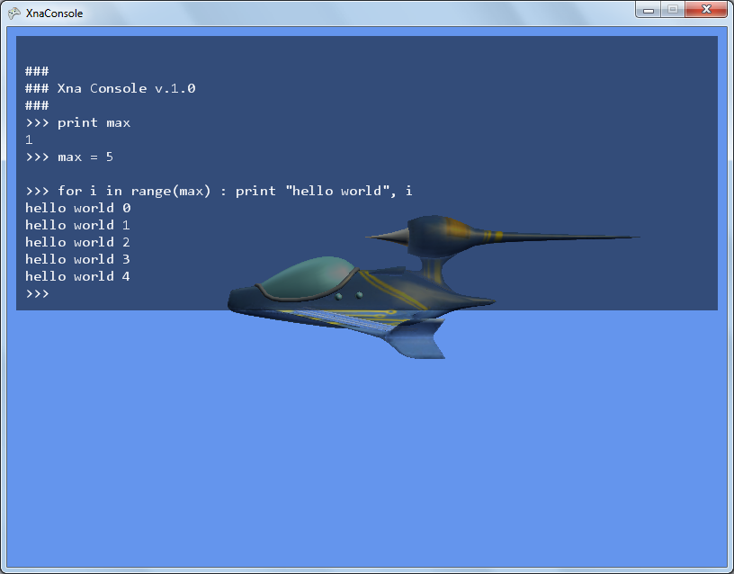
Implementation

Slide 9
How it works
Console gathers keyboard input into string
On [Enter] PythonInterpreter.Execute(inputStr)
String is send to PythonEngine.Execute(inputStr)
Receive byte array via PythonEngine.Read(…)
Converted byte stream can be send to Console.WriteLine()
Back to beginning: console awaits input

Slide 10
How it works
Other interpreters can be used
An interface with basic methods is included
Complexity depends on interpreters

Slide 11
Summary
Pros
Nice tool to check variable status
Change attribute values
Interpreters can be changed
Cons
Only public and protected attributes can be read
Changing attribute values in console can be a mess, e.g. changing Vector3 values
Special characters crash game
Notes:
No Documentation!

